Slide 1
ANY QUESTIONS?
Lesson 11

Slide 2
How many scenarios for Q & A?

Slide 3
Q & A
Deal w/ interruptions
Deal w/ questions
Don’t understand
Don’t answer
Wrap up the answer

Slide 4
A. DEALING WITH INTERRUPTIONS/ POSTPONING ANSWERS
If you don’t mind, I’ll deal with this question later in my presentation.
Can/Could we get back to that a bit later?
Would you mind waiting with your questions until the question and answer session at the end?

Slide 5
B. DEALING WITH QUESTIONS
DON’T UNDERSTAND the question 🡪 repetition/ clarification
I’m sorry. Could you repeat your question, please?
I’m afraid I didn’t quite catch that.
I’m afraid I don’t quite understand your question.
I’m sorry. I didn’t know what you mean?
I’m afraid.. Sorry.. Could you be a bit more specific?

Slide 6
B. DEALING WITH QUESTIONS
DON’T UNDERSTAND the question 🡪 repetition/ clarification
So, what you are asking is:…
If I understand you correctly, you want to know…
Ok, let me just repeat your question so everybody can hear it.
If I could just rephrase your question…
So, you mean…

Slide 7
B. DEALING WITH QUESTIONS
2. DON’T ANSWER
Admitting that you don’t know the answer to the question
I’m sorry. That’s not my field.
I’m afraid I don’t know the answer to your question, but I’ll try to find out the answer for you.

Slide 8
B. DEALING WITH QUESTIONS
2. DON’T ANSWER
Give a reason for not answering the question right away in a smart way
- If you don’t mind, I’d prefer not to discuss that today.
- I’m afraid that’s not really what we’re here to discuss today.
- That’s a great question. However, I would like to answer this question at some other time/ later on.

Slide 9
B. DEALING WITH QUESTIONS
2. DON’T ANSWER
Hand the question over to someone else (if applicable) politely
I’m sorry. That’s not my field. But I hope my teammate, Peter Bott, could answer your question.
I would like to hand this question over to Peter Bott.
I’m afraid that I’m not in a position to answer that. Perhaps Peter Bott could help.

Slide 10
B. DEALING WITH QUESTIONS
3. Wrap up the answer
Well, … does that answer your question?
I hope that answers your question.

Slide 11
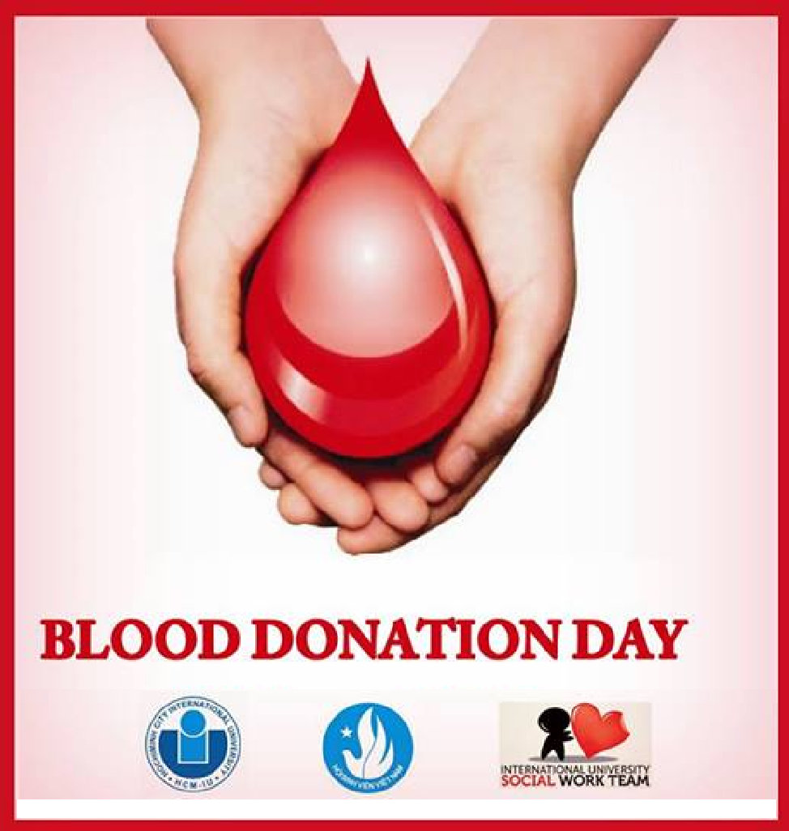
PRACTICE
Share Your Love - Save Their Lives
Deliver one Point of your choice.
If there is no interruption, please assume you have reached the end of the talk and begin the Q & A session.

Slide 12
Point 1
Transition:
First of all, there’s sad news that “blood shortage is becoming a trend in Vietnam”.
According to WHO, each year our country needs roughly about 1.6 million units of blood for treatments. However, just about 30% of this need is currently met. If you happen to think that 30% is not a small number, I just want you to think of some scenarios.
- If you were in the 70% group, what would you do?
- If you were at the dead-end road, what would you do?
Of course, seizing anything as your last resort is a must, simply because you have no other choices. Therefore, it comes naturally that in these cases, the patients must depend on unreliable sources of blood.
However, the bad news is unreliable usually comes along with illegal. What’s more, illegal and low quality are different two words but just on the same side of one muddy road.
Consequently, in this case, it just makes the matter worse.
To prevent this kind of tragedy from recurring, we must stand up to face it. We must act immediately to reverse this trend. We must find the “healthy blood” to cure this “disease”. And finally, we must deliver this “good guy” quickly to the needy.
Luckily, we don’t need to search far and wide for this “good guy” since he stays inside you, inside me, inside all of us. And all you need to do is open your heart and share your blood.

Slide 13
Point 2
Transition: Now that you’ve realized the importance of blood donation. I’ll move on to talk about what you have to prepare for this special day to make it fulfilling.
First of all, keep yourself not only mentally but also physically healthy. In the night before the donation day, you have to go to bed early because it can help you manage the serotonin – a chemical produced in the human brain to control the feelings. In addition, taking any alcohol or stimulants right before the big day is the strictest prohibition. You may have already known how terrible it is if one person receives that bad blood. Therefore, please, be very careful with that. Please keep yourself strong to have the high quality blood in you and in others.
Second, on the big day, remember to wear comfortable clothes with short sleeves or sleeves that can be rolled up to your elbow. Loose costumes will help doctors take out your blood more easily. And don't worry about anything. Our volunteer staffers will take good care of you and we will help you check your health. After completing the procedure, you can start donating your blood. The amount of blood taken depends on your health condition. A cup of sweet tea may balance your blood and get you back to normal after the blood take-out.
Finally, several days after the donation, you need to balance your meals with various types of food: meat, milk, eggs or anything that contains more proteins to ensure the body gets enough nutrients and produces blood to make up for the donated blood. Furthermore, iron plays a vital role in the blood reproducing process in your body, so eating more iron rich food can help you gain new blood quickly after donation.

Slide 14
Point 3
Transition: Benefits for your community and yourself
The most important gain that needs to be mentioned first thing first is that you will have a sense of satisfaction when you can help your fellow men to live their lives. In fact, this is the biggest reward because after all, we all live in a society and we need to have social responsibility, right? Well, would it surprise you if I told you that each and every one of you could save 18 lives every year? Well, this statement is very true according to the website www.healthcarecommunication.com. It’s not a boast if we call you a great hero!
In addition, did you know that you can reduce your risk of heart disease and save a life at the same time? That’s right! According to studies published in the American Journal of Epidemiology, blood donors are 88% less likely to suffer a heart attack and 33% less likely to suffer any type of cardiovascular event. Why is that? One explanation is that iron has a significant impact on atherosclerosis, or hardening of the arteries. When you give blood, you are removing 225 to 250 milligrams of iron from your system, thus cutting your risk of heart disease.
Another benefit that you can gain is you can replenish, or refresh your blood. After donating, the human body replaces the blood volume within 48 hours of donation, and all of the red blood cells lost during donation are completely replaced within four to eight weeks. This process can help your body stay healthy and work more efficiently and productively.

Slide 15
FINAL ASSIGNMENT – PAIR WORK
Task: One 6-8 minute presentation with visual aids on
Topic: A course or a skill-building project which is fun or entertaining for college students
The objective of the presentation is (1) to motivate your peer students to learn with fun
Organization: 1) Problem/Need
2) Proposed action
3) Impacts/Benefits
Notes: - Script MUST indicate writing techniques
- Slides should include authentic pictures with sources, not cartoons
Notes:
Group registration
Group 5:
https://docs.google.com/spreadsheets/d/1x5yxzGbt1xpl18vgd8Tg7iNpZSXe4orN/edit?usp=sharing&ouid=110083330470346403343&rtpof=true&sd=true
Group 7:
https://docs.google.com/spreadsheets/d/1xW5khb3Ss6WjON-sLA-hYieAOqf6Dauy/edit?usp=sharing&ouid=110083330470346403343&rtpof=true&sd=true
Group 8:
https://docs.google.com/spreadsheets/d/1NZiATSBC2gfxX7x9VfmpTHp8d2MGOupC/edit?usp=sharing&ouid=110083330470346403343&rtpof=true&sd=true

Slide 16
Link to submit scripts + slides
Presentation time: Week 14 (Jan 3) + Week 15 (Jan 7)
Script + slides submitted before Jan 3
https://drive.google.com/drive/folders/1HqXIY95yAUeScOUFBB72KaBrlvouKfly?usp=sharing

